Slide 1
Infinera No_code AI

Slide 2
What do you re collect when you hear
“Machine learning”
Ping on chat

Slide 3
What can be expected from this session ?
Understanding basic machine learning concepts using intuitive visualization tools ?
Build intuition around
image detection concepts and model architecture

Slide 4
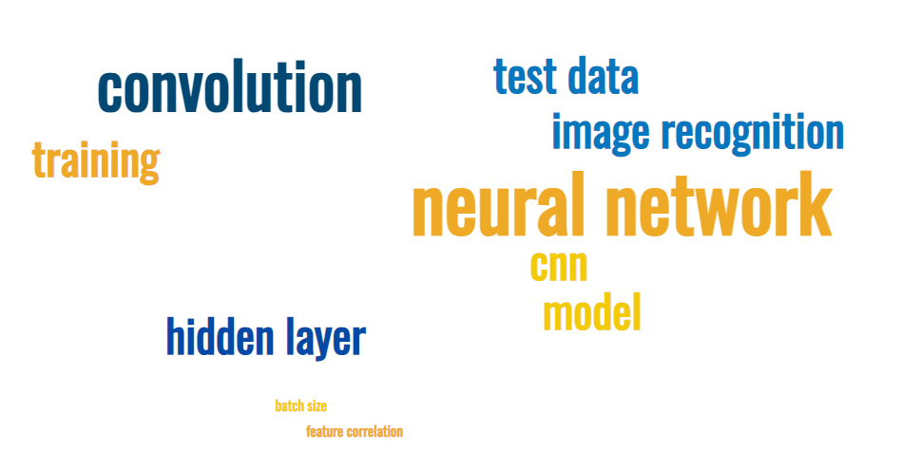
Have you heard about ?
We will understand all these terms with help of Visualization tools

Slide 5
Agenda
Steps building a machine learning algorithm ?
What is a machine learning ? Algorithm Vs model What is a linear algorithm and data set ? How do we solve nonlinear data set problem ?

Slide 6
Difference between
“machine learning”
&
“deep learning”
Ping on chat

Slide 7
Machine learning algorithm Vs Machine learning model
Rules
Algorithm
Set of rules with no input data
Eg: y = mx + b
O/p prediction
Model
Trained
Rules
Input Data
Expected value Value
Eg: y = 3x + 2

Slide 8
Algorithm is something which when trained on data gives a model.
Algorithms are a combination of mathematical concepts applied along with statistics
Algorithms and model created using algorithms can be explained…

Slide 9
Why do we need Deep learning ?

Slide 10
Intuition – Dimensionality
How do you find the model to predict
Consider this data set ?
What did we learn ?
We can find patterns in multidimensional space

Slide 11
“dimension”
So what is a dimension
Name
Manish
Joe
Prakash
Name | Age
Manish | 44
Joe | 35
Prakash | 43
Name | Age | M/F
Manish | 44 | M
Joe | 35 | M
Prakash | 43 | F
Is there anything common ?
Can you find any pattern ?
Is there anything common ?
Is there anything common ?
Single dimension
Two dimension
Three dimension
While higher # of dimensions improves the predictability order of complexitiy to detect (dis)similarity has to considered

Slide 12
Algorithms can do a good job but as the number of dimensions increases it is difficult to converge to a algorithmic model

Slide 13
Example
Can we define an algorithm to detect faces, objects in image ?
What do you think ?
Ping on chat

Slide 14
Why not ?

Slide 15
Why not ?
Full frame photos are 1080 * 720 pixels
So how many dimensions for a single picture =
777,600

Slide 16
What do we need in a solution ?
1. Infinite pattern recognition
2. Non – Linear

Slide 17
What is the solution ?
Deep Learning – Neural network
Neural networks is an implementation of deep learning
Ability to add multiple neurons/cells and layers
Nonlinear activiation functions

Slide 18
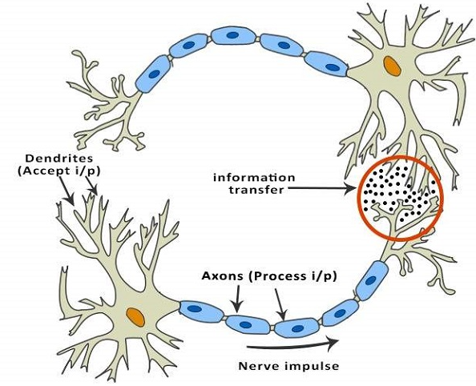
Difference between Machine learning and Deep Learning ?
Deep learning models were built with an intent to mimic human brain
Deep learning models are “black box” cannot be explained
Deep Learning Model Components | Human Brain Components
Artificial Neurons | Neurons
Activation Functions | Dendrites
Synapses | Axons
Weights | Synapses
Biases | Neurotransmitters
Layers | Neural Networks

Slide 19
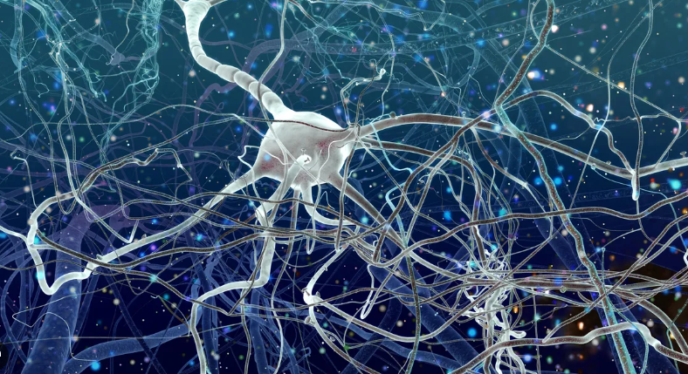
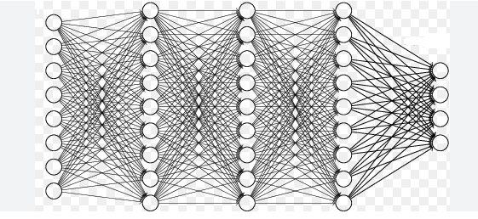
Physical -> Logical
Physical -> Logical

Slide 20
Let's Visualize

Slide 21
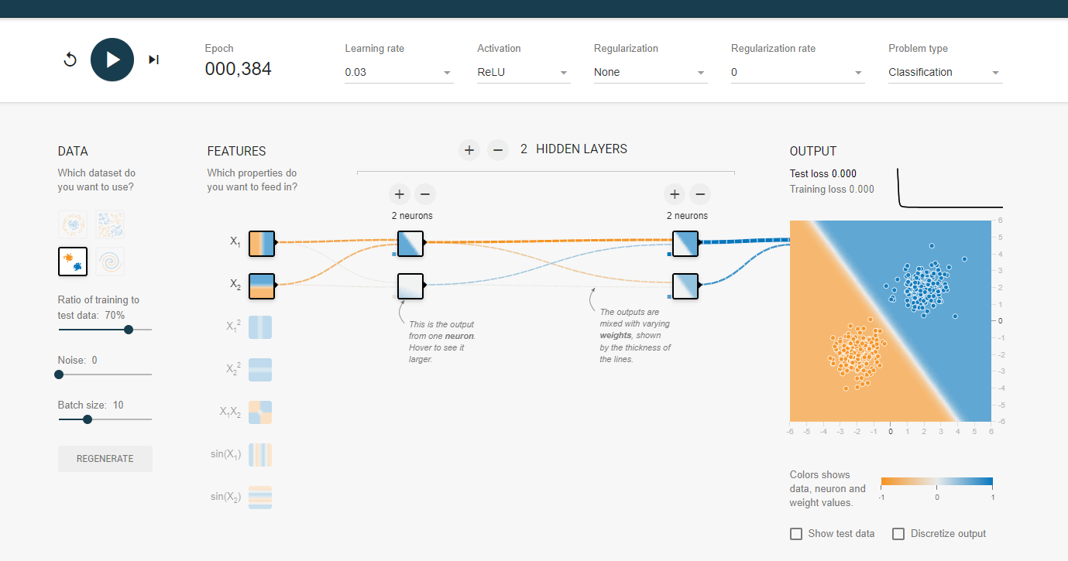
https://playground.tensorflow.org/#activation=relu&batchSize=10&dataset=gauss&regDataset=reg-plane&learningRate=0.03&regularizationRate=0&noise=0&networkShape=2,2&seed=0.78221&showTestData=false&discretize=false&percTrainData=70&x=true&y=true&xTimesY=false&xSquared=false&ySquared=false&cosX=false&sinX=false&cosY=false&sinY=false&collectStats=false&problem=classification&initZero=false&hideText=false

Slide 22
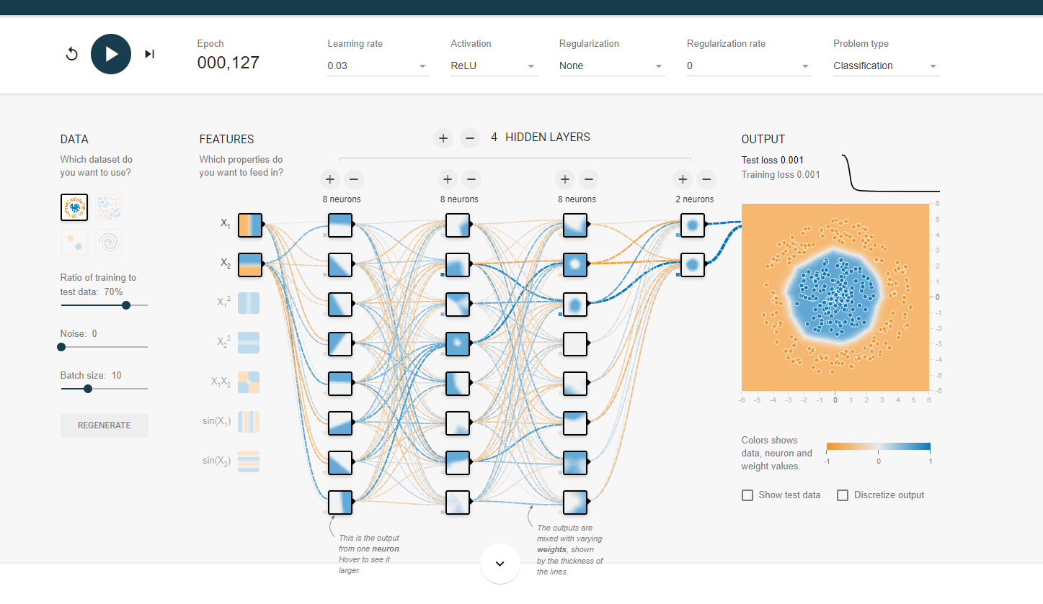

Slide 23
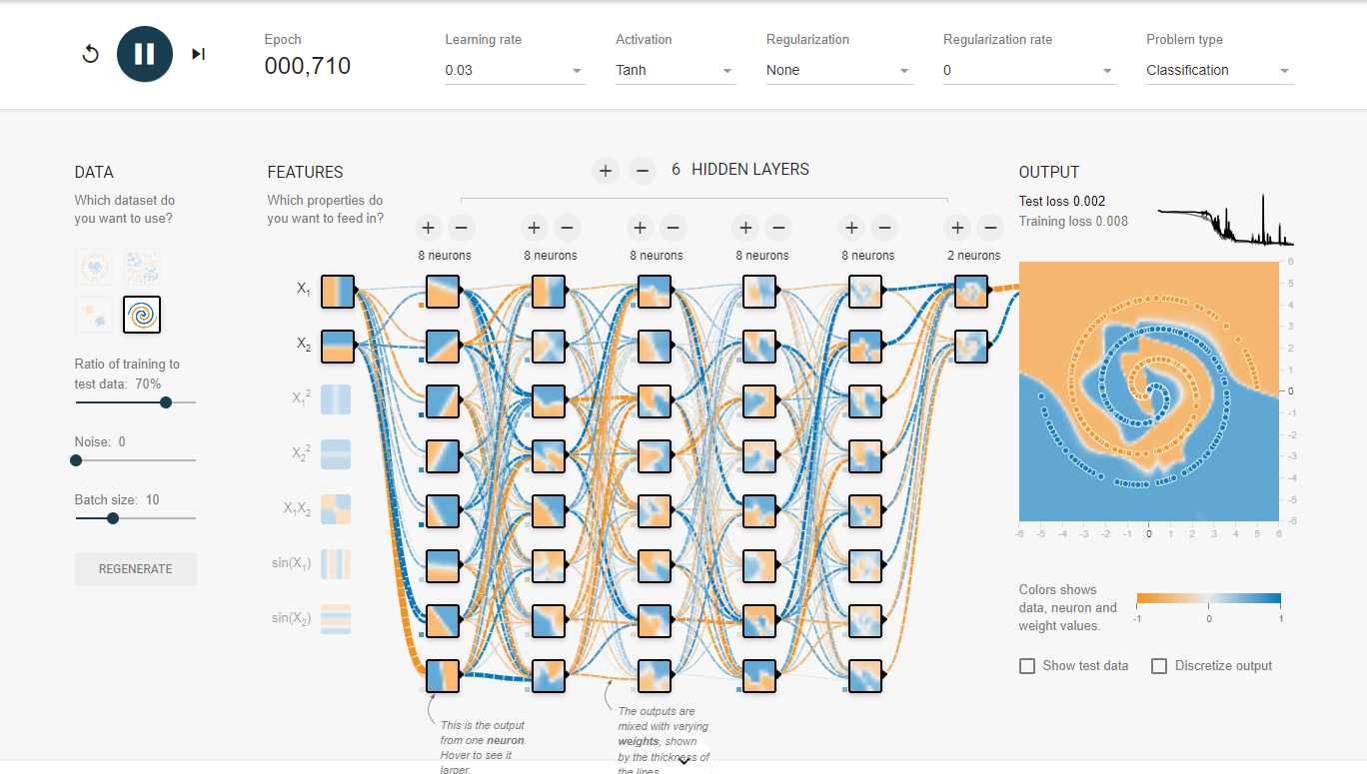

Slide 24
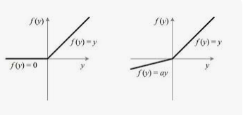
RelU
he Rectified Linear Unit is the most commonly used activation function in deep learning models. The function returns 0 if it receives any negative input, but for any positive value x it returns that value back. So it can be written as f(x)=max(0,x).

Slide 25
Image Recognition

Slide 26
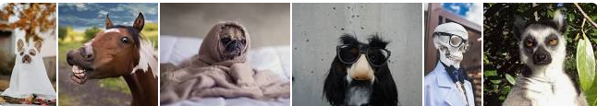

Cannot be explained algorithmically.
Options: Neural networks

Slide 27
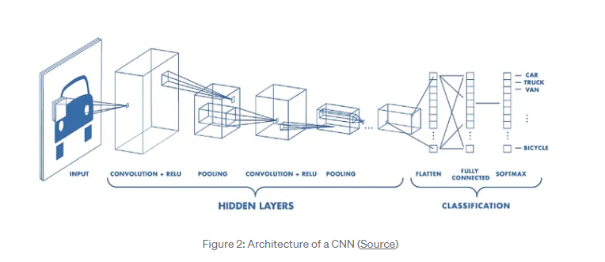
Different layer in image detection models(CNN)

Slide 28
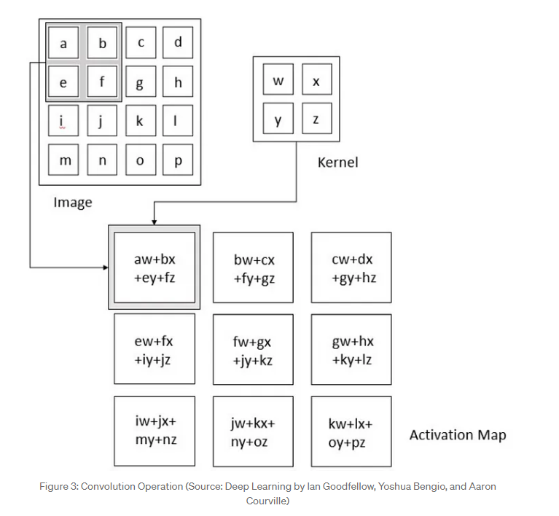

Convolution
Feature detector
https://medium.com/@ageitgey/machine-learning-is-fun-part-3-deep-learning-and-convolutional-neural-networks-f40359318721
sparse interaction, extract features from input image, need to store fewer parameters ,improves the statistical efficiency

Slide 29

Convolution
http://deeplearning.stanford.edu/wiki/index.php/Feature_extraction_using_convolution

Slide 30
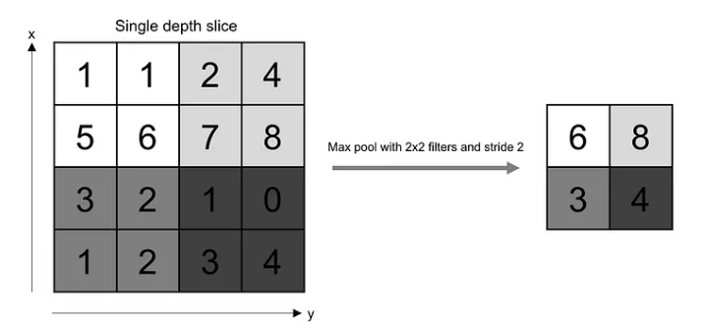
Pooling
Reduce spatial size

Slide 31
Let's Visualize
Industry first models
LeNet
AlexNet
ResNet-50

Slide 32
LeNet https://tensorspace.org/html/playground/lenet.html
Handwritten character recognition
Seven layers
C1 (Convolutional Layer): Applies a set of convolutional filters to the input image. In LeNet-5:
Input image size: 32x32 pixels.
Convolution kernel size: 5x5.
Number of filters: 6.
Output feature map size: 28x28 (due to the 5x5 convolution).
Trainable parameters: 122,304 (156 per filter).
S2 (Pooling Layer): Performs downsampling by taking the maximum value within a 2x2 region.
Input feature map size: 28x28.
Output feature map size: 14x14 (due to downsampling).
Trainable parameters: 12 (2 per filter).
C3 (Convolutional Layer): Similar to C1 but with 16 filters.
S4 (Pooling Layer): Downsampling again (2x2 max pooling).
C5 (Convolutional Layer): 120 filters.
F6 (Fully Connected Layer): 84 neurons.
Output Layer: Typically used for classification (e.g., recognizing digits).

Slide 33
Going back to Kernels/Filters
Visualize how do they really work ?
https://setosa.io/ev/image-kernels/

Slide 34
Google Teachable
How to build and host a simple image recognition model

Slide 35
However, with GenAI a lot of these details are abstracted ☹
but it is important to know “abcd” before you can write sentences ☺

Slide 36
Other tools
DATA ROBOT | https://app.eu.datarobot.com/projects/6564473675cd5eac500fb744/models | Building models using auto pilot

